Slide 1

Lecture 2 Introduction to Classes and Objects

Slide 2
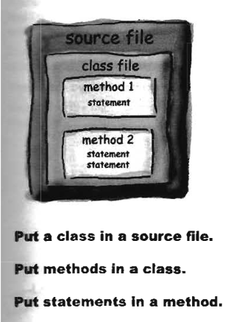
Code structure in java

Slide 3
CLASSES & OBJECTS
A class is
a template, blue print, or contract
that defines what an object’s data fields and methods
An object is
an instance of a class.
You can create many instances of a class
Ex:
class car{}
Car honda = new car();
Car hyundai = new car();
Car audi = new car();

Slide 4
String Class
Its a sequence of characters
String greeting = "Hello world!";
Methods
String Length :
number of characters contained in the string
String str = “HELLO”;
Int len = str.length();
System.out.println(“ length is = “+ len);
O/P = length is 5

Slide 5
String Indexes
String s = “Hello world”;
H | e | l | l | o |  | w | o | r | l | d
0 | 1 | 2 | 3 | 4 | 5 | 6 | 7 | 8 | 9 | 10
The length of s is 11
It has positions from 0 to 10

Slide 6
Concatenating Strings
Joins two string
String str1 = “HELLO”;
String str2 = “WORLD!!!!”;
String str3 = str1.concat(str2);
String str3 = str1 + str2;
O/P : HELLO WORLD!!!!

Slide 7
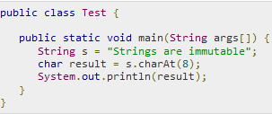
charAt(int index)
returns the character located at the String's specified index

Slide 8
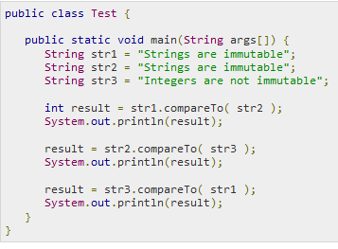

String compareTo(String anotherString)
compares two strings lexicographically.

Slide 9
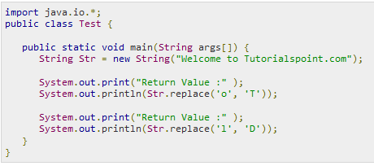
String replace()
returns a new string resulting from replacing all occurrences of oldChar in this string with newChar

Slide 10
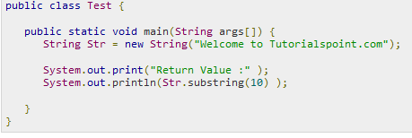
String substring()
eturns a new string that is a substring of this string.
The substring begins with the character at the specified index and extends to the end of this string or up to endIndex

Slide 11

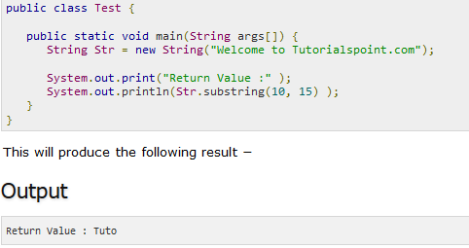

Slide 12
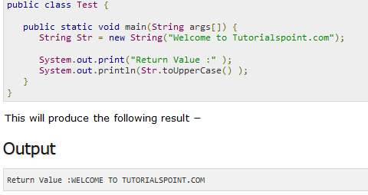
String toUpperCase()
converts all of the characters in this String to upper case

Slide 13
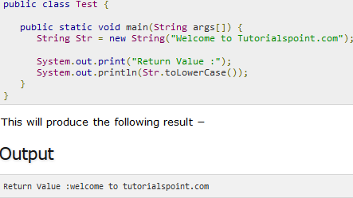
String toLowerCase()
converts all of the characters in this String to lower case

Slide 14
Demonstrate the use of the string class and its method
String is “introduction to java “
Find length , convert to uppercase ,
concate the string with “ Class march 2017”
Substring = “to java”
Replace o to Z in string “introduction to java”

Slide 15
Packages
The classes of the Java standard class library are organized into packages
Some of the packages in the standard class library are:
Package
java.lang
Java.math
java.applet
java.awt
javax.swing
java.net
java.util
javax.xml.parsers
Purpose
General support
Performs mathematical functions
Creating applets for the web
Graphics and graphical user interfaces
Additional graphics capabilities
Network communication
Utilities
XML document processing

Slide 16
The import Declaration
When you want to use a class from a package
import java.util.Random;
To import all classes in a particular package, you can use the * wildcard character
import java.util.*;
Import statements are always at the top of the program.
import java.lang.*;

Slide 17
The Random Class
It provides methods that generate pseudorandom numbers
Random r = new Random( );
Float nextfloat() | Generates random number between 0.0 to 1.0 r.nextFloat();
Int nextInt() | Generates a random number over all possible int values ( +ve and –ve both) r.nextInt()
Int nextInt(int num) | Returns a number in the range 0 to num-1 r.nextInt(10)

Slide 18
Random examples
Random rand = new Random();
A random number between 0 and 19 inclusive:
int random1 = rand.nextInt(20);
A random number between 1 and 10 inclusive:
int random1 = rand.nextInt(10) + 1;
A random number between 4 and 17 inclusive:
int random1 = rand.nextInt(14) + 4;

Slide 19
Math class
contains static methods for common mathematical operations (for which an operator does not exist in Java)

Slide 20
Java's Math class
Method name | Description
Math.abs(value) | absolute value
Math.ceil(value) | moves up to ceiling
Math.floor(value) | moves down to floor
Math.log10(value) | logarithm, base 10
Math.max(value1, value2) | larger of two values
Math.min(value1, value2) | smaller of two values
Math.pow(base, exp) | base to the exp power
Math.random() | random double between 0 and 1
Math.round(value) | nearest whole number
Math.sqrt(value) | square root
Math.sin(value) Math.cos(value) Math.tan(value) | sine/cosine/tangent of an angle in radians
Math.toDegrees(value) Math.toRadians(value) | convert degrees to radians and back
Constant | Description
Math.E | 2.7182818...
Math.PI | 3.1415926...

Slide 21
double result = Math.pow(3, 4);
System.out.println(result); //81
double squareRoot = Math.sqrt(121.0);
System.out.println(squareRoot); // 11.0
int absoluteValue = Math.abs(-50);
System.out.println(absoluteValue); // 50
System.out.println(Math.min(3, 7)); // 3

Slide 22
clicker Question
What is output by the following code?
double a = -1.9;
double b = 2.65;
System.out.print( Math.floor(a) +
" " + Math.ceil(b));
1.0
-1.0 3.0
1 3
-1 3
-2.0 3.0

Slide 23
Enum datatype
A type of objects with a fixed set of constant values
Enums are lists of constants.
When you need a predefined list of values which do represent some kind of numeric or textual data, you should use an enum..
public enum Name {
VALUE, VALUE, ..., VALUE
}
enum season {winter, spring, summer, fall}

